Slide 1
Data science NOTEBOOK
by Bryan Tjandra
Source : udemy.com/course/python-for-data-science-machine-learning

Slide 2
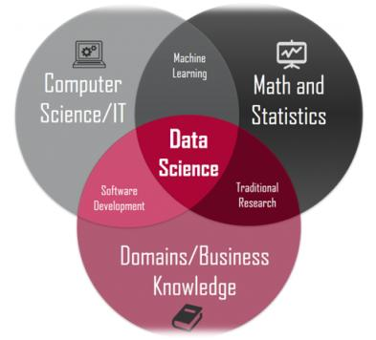
DATA SCIENCE
Data science is a study that combines domain expertise, programming skills, knowledge of mathematics and statistics, and business to extract meaningful insights from data.
By 2020, it's estimated that 1.7MB of data will be created every second for every person on earth.
DS -> fast growing job with one of the highest IT salary
Data is very massive and have been used massively for bussines needs or everyday life. Example : face recognition
https://medium.com/@jrendz

Slide 3
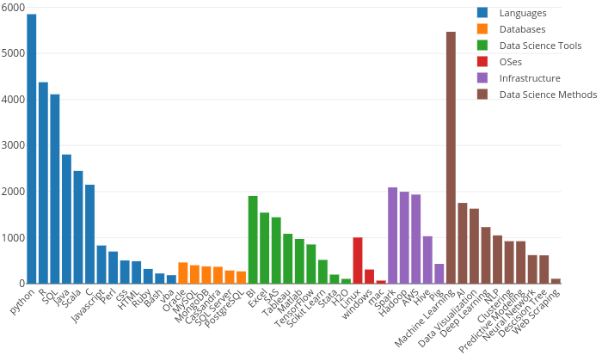
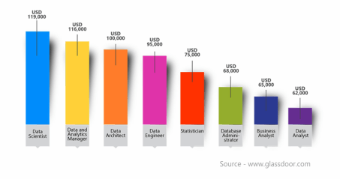
Type of data job :
Data Science -> Create model for prediction (future)
Data Analyst -> Identify trend and conclusion (past)
Data Engineer -> Clean , organize data (ex. Filling missing value)
Business Intelligence -> Analyze data for business importances
Data Science and Analyst overlap.

Slide 4
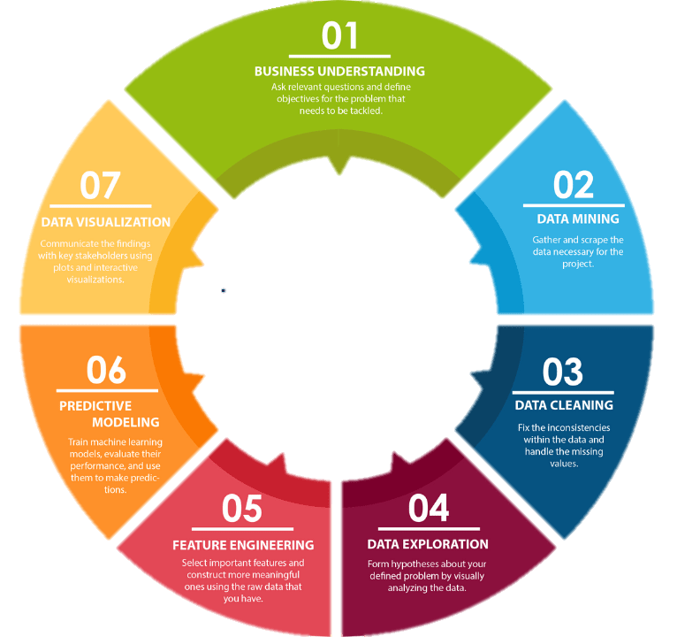
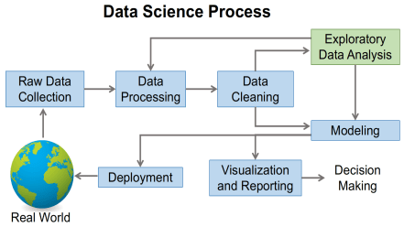
DATA SCIENCE
LIFE CYCLE
towardsdatascience.com
medium.com/@vanshikagoel

Slide 5
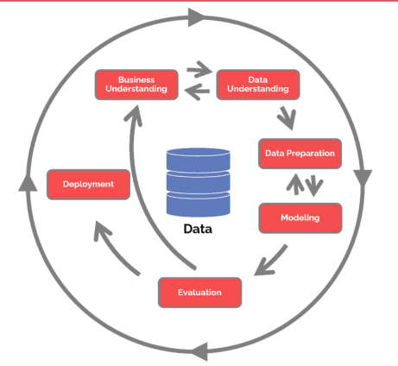
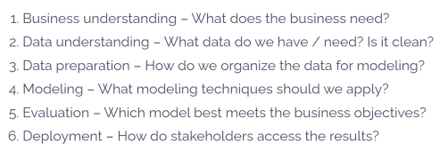
The CRoss Industry Standard Process for Data Mining (CRISP-DM)
a process model with six phases that naturally describes the data science life cycle.
https://www.datascience-pm.com/crisp-dm-2/

Slide 6
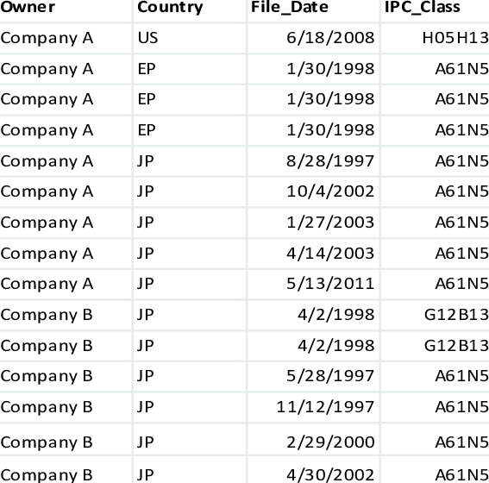
DATA
Type of Data :
Categorical
Nominal. Ex : Female , Male
Ordinal. Ex : Elementary, High School, Undergraduated
Numerical :
Discrete (1, 2, 3)
Continous (1.1, 2.19, 3.14)
The data that we will use is tabular data , the shape is like the picture on the side

Slide 7
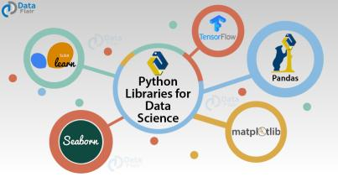
PYTHON
We use python for data science , because python provides modules / packages that helps to deal with data and because it is easy to use and has simple syntax.
Module that we need in Python for Data Science:
Numpy , Pandas -> Data Manipulation
Maplotlib , Seaborn -> Data Visualization
Scikit-Learn -> Machine Learning
Tensorflow , Keras -> Deep Learning
Recommended environment for Data Science -> Google collab . Google collab is a place where you can access it in the browser with no installation , can be used to create notebook ,and free limited uses for GPU (to fasten computational process, rather than CPU)
data-flair.training

Slide 8

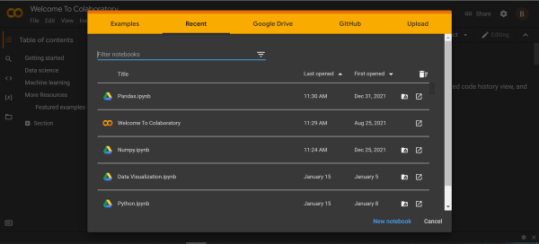
GOOGLE
COLAB
Google Colab :
Open colab.research.google.com
Click File -> New Notebook , or if it shows pop up, directly click new notebook or chose existing notebook

Slide 9
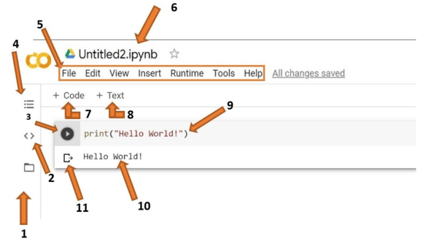
Preview after open colab notebook
Tools:
Files: Upload files that you want to use
Code Snippets: find prewritten code for some functions
Run Cell: Run the code
Table of Contents
Menu Bar
File Name: name of your file
Insert Code Cell: Add code cell
Insert Text Cell: Add text cell
Cell: Write your code
Output: Output of your code
Clear Output: clear output
runestone.academy/ns/books/published//httlads/PythonReview

Slide 10
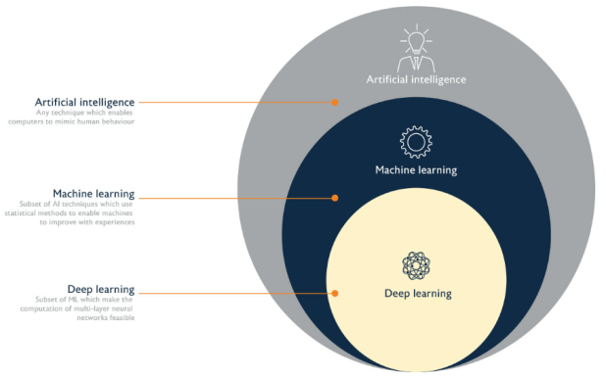
AI , ML , DL
AI -> A machine that mimics human intelligence . AI is a technology
ML -> A study of algorithms that can improve automatically through experience and by the use of data
DL -> part of machine learning methods based on artificial neural networks . DL is inspired by humans neuron
blogsinsider.blogspot.com/2018/10/relationship-between-ai-ml-dl.html

Slide 11
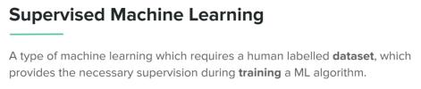
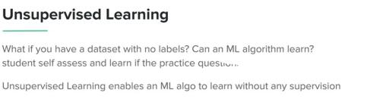
MACHINE LEARNING
Machine learning (ML) is the study of computer algorithms that can improve automatically through experience and by the use of data. There are two types of Machine Learning:
Supervised Machine Learning (Learn from given data input and output to create algorithm):
Classification
Regression
Unsupervised Machine Learning (Learn from given data input but no output to create algorithm, the machine tries to learn pattern of given data input):
Clustering
Anomaly Detection

Slide 12
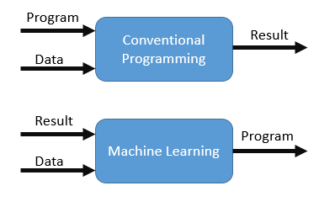
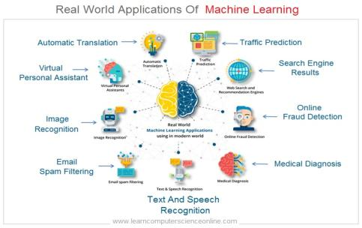
Conventional programming -> programs are made by human . Then , given some data / input to produce result / output
Machine learning -> From a sample of data / input and sample of result / output ,machine creates the algorithm / program
https://rstefanus16.medium.com
Application of ML :
Recommendation system (Ex. what to watch on netflix)
Email spam filtering
Social Media
Traffic Prediction
learncomputerscienceonline.com/what-is-machine-learning

Slide 13
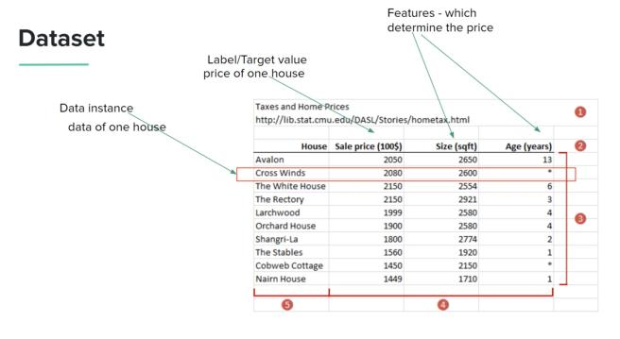
ML creates algorithm from the given input (dataset) and predict output. Three important phases in machine learning :
Train Machine Learning Algorithm
Evaluate Algorithm
Making Prediction
DATASET
Datasets contain of row (amount of data) and column (amount of variable)
Feature -> The column that is used for algorithm training
Target -> The column that is used for prediction

Slide 14
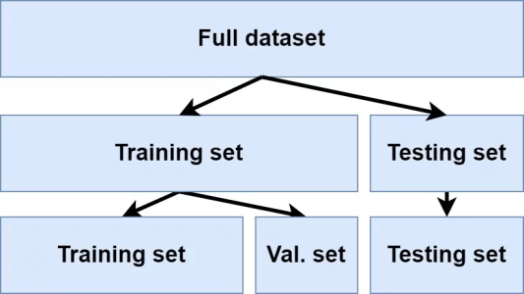
TRAIN, VALIDATION, TEST
In Machine Learning , we usually divided dataset into 3 parts : Training Set , Validation Set . Testing Set
Training Set : to train multiple machine learning models
Validation Set : to select best models and tune hyperparameter
Testing Set : to evaluate model, check the model score
After the model has a good result . The models are ready to deployed

Slide 15
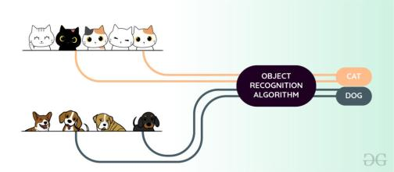
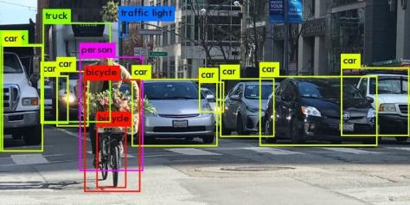
CLASSIFICATION
www.geeksforgeeks.org
Classification -> Model tries to classify data
Given an example of input and output , machine learn algorithms. Example , img_1 : dog , img_2 : cat , img_3 : dog , img_4 : cat
The machine learns from that given data . Then, if there is img_5 , the machine should classify whether img_5 is a cat or dog from the knowledge that the machine has learned
https://azati.ai

Slide 16
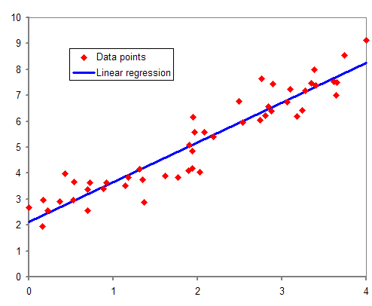
REGRESSION
Regression -> estimating trend
Example given a data :
if x = 1 , then y = 2
If x = 3 , then y = 6
If x = 10 , then y = 19
If x = 30 , then y = 61
From the given data , what is the value of y given x = 100. The answer is probably around 200 , because the estimated equation from the data is y = 2x.
This is an example of Regression task. Another real life example is when we want to predict estimated house price.
en.wikipedia.org/wiki/Regression_analysis

Slide 17
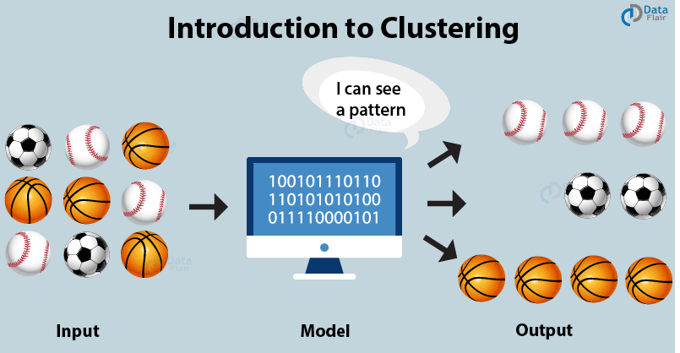
CLUSTERING
Clustering -> Seperating data into several groups
Given data input , a model tries to find the pattern similiarity between each of inputs. Then , separate the input into several groups based on their pattern similiarity.
Example : Based on the image , the model separates balls into 3 groups based on their similarity . But the model doesn’t know the ‘label’ name of each ball. The one that it knows is these balls are similar, but the model doesn’t know whether the name is basketball or football.
data-flair.training/blogs/clustering-in-machine-learning

Slide 18
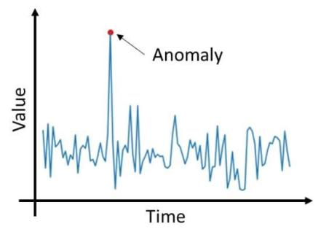
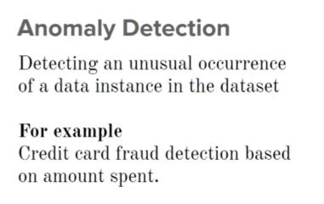
ANOMALY DETECTION
medium.datadriveninvestor.com

Slide 19
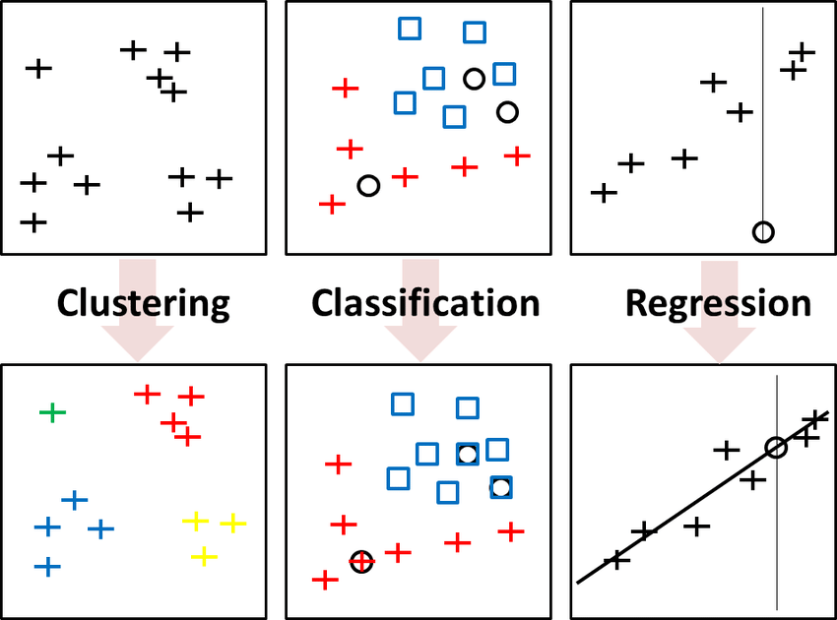
3 Main problems in data science:
Classification: Classify data
Regression: Estimating relationship
Clustering: Segregate data into groups
www.researchgate.net/publication

Slide 20
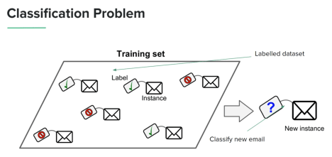
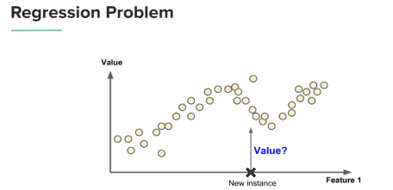
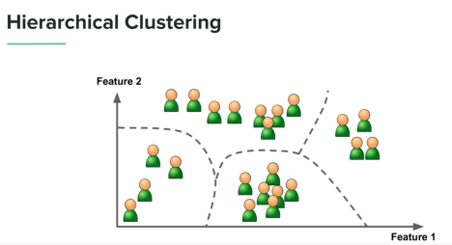
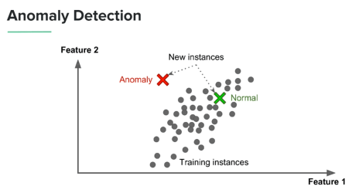

Slide 21
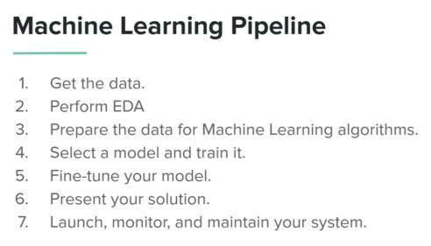
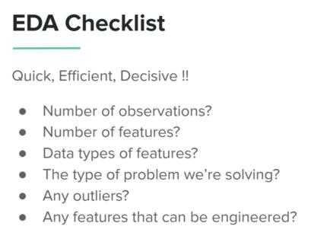
EXPLORATORY DATA ANALYSIS
EDA -> analyze data , visualize , find insights , find missing value , etc
After doing EDA , we prepare the data -> clean data , fill missing value , change categorical to numerical, etc

Slide 22
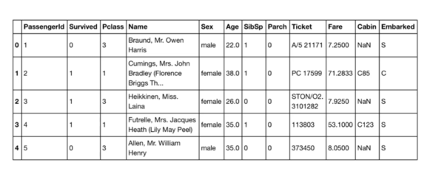
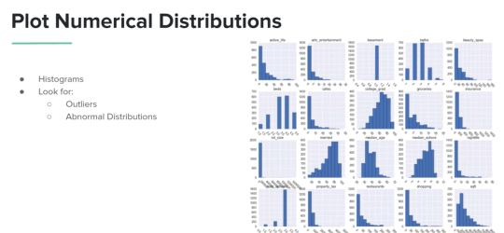
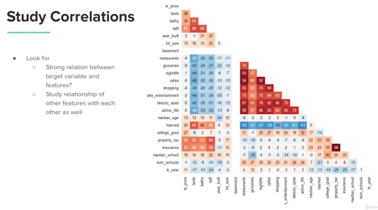

Slide 23
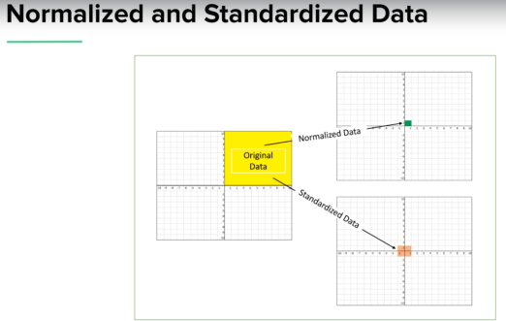
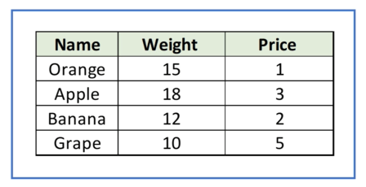
PREPARE DATA
SCALING DATA
We use scaling when using Machine Learning Algorithm that calculate distance of the data

Slide 24
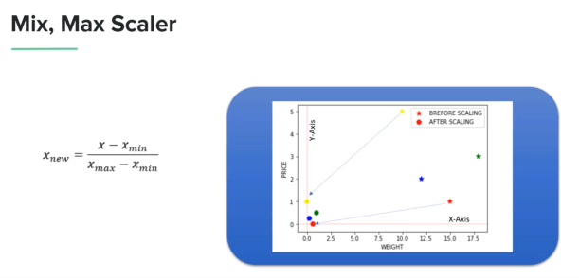
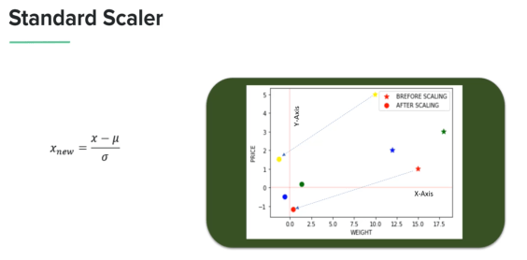

Slide 25
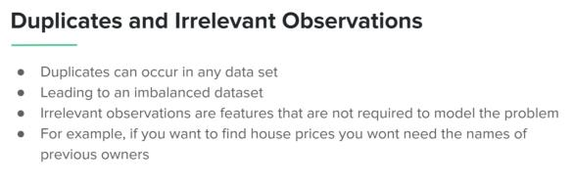
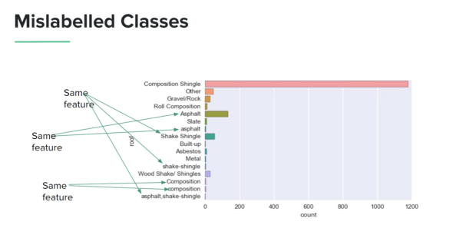
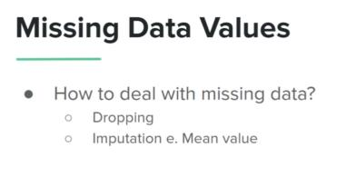
CLEANING DATA
Format consistency, ex : YYYY-MM-DD
Imbalanced data, ex : 90 A , 10 B

Slide 26
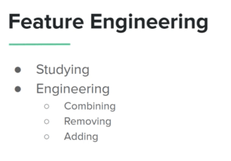
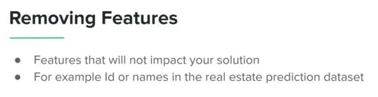
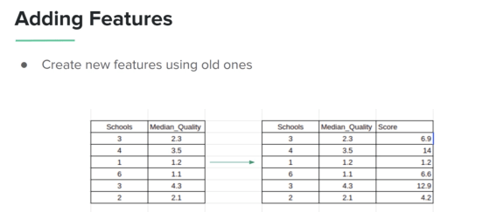
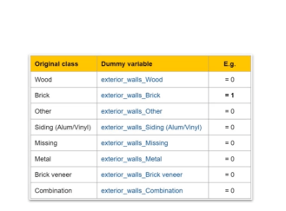
FEATURE ENGINEERING
Dummy Variable

Slide 27
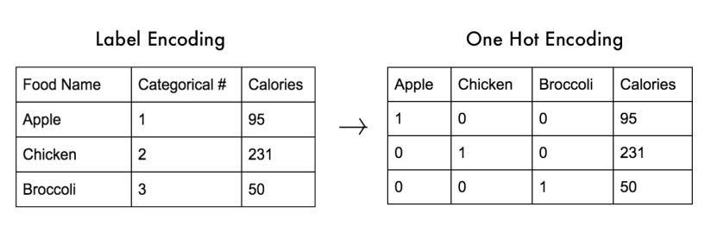
While training machine learning models/algorithm , we can’t have categorical feature. Thus, we need to do feature engineering on categorical data. There are two ways to encode categorical feature to numerical.
Label Encoding -> converting string labels into ordered numbers. We don’t need to add additional feature.
One Hot Encoding -> converting string labels into binary number. We need to add features based on the labels name , and set 1 if the label and the feature name are the same , else 0

Slide 28
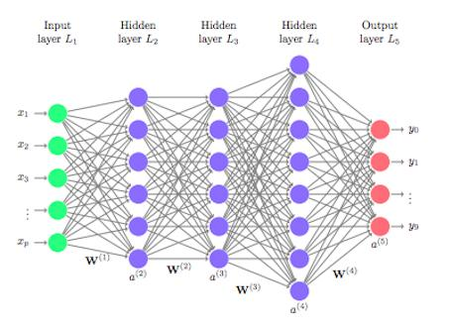
DEEP LEARNING
DL is used to solve complex problem (unstructured or diverse data)
This is an example of how complex the algorithm in deep learning. The algorithms are similar to humans neural network. Each dot is a node. Every node are connected on each next node.
Every DL structures have input , hidden layer, and output. ‘Deep’ refers to how many hidden layers in the algorithm. In real life problems , an algorithm can have more hidden layer

Slide 29
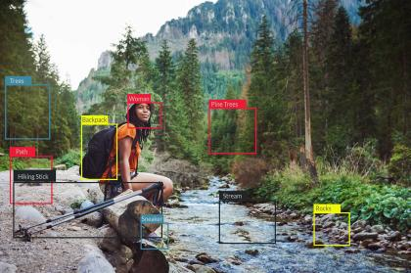
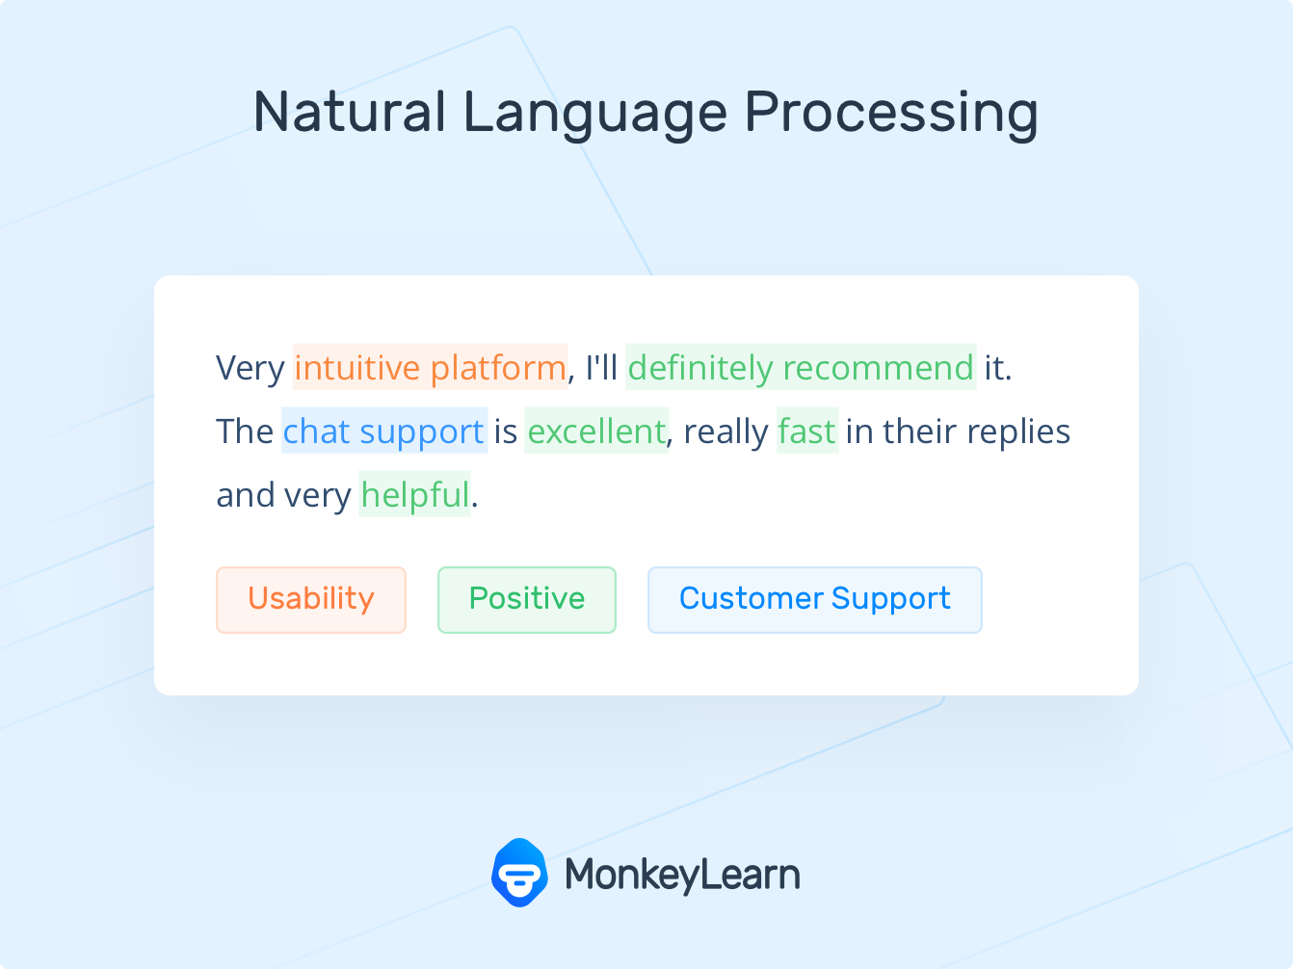
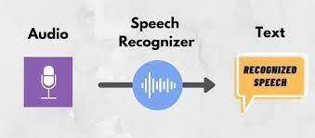
Application of DL :
Speech Recognition
Image recognition
Natural Language Processing (NLP)
perficient.com/insights/research-hub
monkeylearn.com/natural-language-processing
towardsdatascience.com

Slide 30

DATA VISUALIZATION
Charts and Graphs uses:
Composition
Pie Chart
Stacked Bar chart
Distribution
Histogram
Kernel Density Plot
Relationship
Scatter Plot
Correlation Matrix
Comparison
Line Chart
Bar Chart

Slide 31


DASHBOARD
A dashboard is made up of a collection of easy-to-read charts and graphs that provide visual representation of filtered data. A dashboard is used to dispay important data (usually for stakeholders)

Slide 32

Univariate -> visualize 1 variable / feature / column
Multivariate -> visualize 2 or more variables

Slide 33





Slide 34



Slide 35




Slide 36




Slide 37




Slide 38



Slide 39



Visualization tools:
Pandas Visualization
Matplotlib
Seaborn

